Slide 1
VIDYA JYOTHI INSTITUTE OF TECHNOLOGY
(Autonomous)
Adversarial Image Colorization: A GAN-Based Approach for Converting Grayscale Images to Vivid Color
Under the guidance of:
Dr. A. Anusha
By :
Kethavath Lavanya Mali Sreehithi Reddy Sampally Chaithanya
Kalakoti Pranitha
[21911A3527] [21911A3531] [21911A3549] [21911A3525]
Department of Artificial Intelligence

Slide 2
Problem Statement
Problem Statement :
Gray scale images lose their vibrancy and contextual clarity, making it difficult to analyze or relive historical moments visually. Manual colorization is time-consuming and subjective.
Problem Description :
Traditional colorization methods are time-consuming and inconsistent, often requiring manual work. This project leverages GANs to automate the process by training a model on diverse datasets, allowing it to learn complex color patterns and apply them realistically to grayscale images. The solution has applications in restoring historical photos, colorizing films, and artistic enhancements.
Department of Artificial Intelligence

Slide 3
Abstract
This project explores the use of Generative Adversarial Networks (GANs) for automatic grayscale image colorization. Traditional methods for adding color to grayscale images are time- consuming and often yield inconsistent results. By leveraging a GAN architecture, where one network generates color images and another evaluates their realism, the model learns to produce vibrant, natural-looking colorizations that align with the content of the original image. Trained on large datasets, the GAN captures complex color patterns and textures, delivering visually appealing and contextually accurate results. This approach has significant applications in areas like historical photo restoration, film colorization, and artistic enhancements, showcasing the potential of GANs in advancing image processing technologies.
Department of Artificial Intelligence

Slide 4
Literature Survey
Ref No | Author Names | Dataset | Model / Method | Strengths | Weakness | Evaluation Metrics | Year
1 | Richard Zhang | ImageNet | Conditional GAN (CGAN) with U Net | Captures semantic meaning of grayscale images | Limited to dataset diversity | PSNR(Peak Signal-to-Noise Ratio) , SSIM | 2016
2 | Phillip Isola | ImageNet, COCO | Conditional GAN (CGAN) with VGG-16 | General- purpose model, adaptable to many tasks | Struggles with high-res image synthesis | Inception Score | 2018
3 | Chenyang Lei | ImageNet, COCO | Photorealistic Colorization | High-quality and natural colorization | Computationally intensive | (NIQE), Blind/Reference less Image Spatial Quality Evaluator (BRISQUE), Color histogram similarity | 2021

Slide 5
Literature Survey
Ref No | Author Names | Dataset | Model / Method | Strengths | Weakness | Evaluation Metrics | Year
4 | Yuanqi Du | ImageNet, COCO | Pik-Fix: GAN- based Colorization | Effective at restoring damaged photos | Loss of fine detail in complex images | Video Quality Assessment (VQA), Peak Signal-to-Noise Ratio (PSNR) | 2022
5 | Shiguang Liu | ImageNet, COCO | Conditional GAN (CGAN) with VGG-16 | Colorization and decolorization for images and videos | Limited to specific domains | Quality Assessment (VQA), Color histogram similarity | 2022
Department of Artificial Intelligence
5

Slide 6
Literature Survey - Base paper
Colorful Image Colorization
Authors: Richard Zhang, Phillip Isola, Alexei A. Efros, 2016
Overview:
Introduced a CGAN-based method to colorize grayscale images. The model used a UNet architecture and Lab color space for more realistic results.
Strengths:
Creates accurate and natural colors. Better realism than older methods.
Weaknesses:
Sometimes unrealistic colors.
Needs large datasets and powerful hardware.
Impact:
This paper set the foundation for future research in image-to-image translation, influencing colorization, style transfer, and other creative image tasks.
Department of Artificial Intelligence

Slide 7
Existing Systems
Manual Colorization:
Traditionally done by artists, manual colorization is time-consuming, expensive, and prone to subjectivity, leading to inconsistent results across images.
Heuristic-based Methods:
These use rule-based techniques to infer colors but lack flexibility and struggle with complex images. They often produce oversimplified and unrealistic colors.
Machine Learning Approaches:
Early methods used feature extraction and simple neural networks to predict colors, but these approaches
lacked the ability to capture the full context of the image.
Current GAN-based Systems:
Generative Adversarial Networks (GANs) have become the leading technology for automated image colorization. They can learn from large datasets and generate realistic, context-aware colors by modeling the relationship between grayscale and color.
Department of Artificial Intelligence

Slide 8
Proposed System / Innovation
Proposed System:
Uses a DGAN (Dual Generative Adversarial Network) with a pre-trained ResNet for converting gray scale images to color, improving speed and accuracy.
Key Innovations:
Pre-trained ResNet: Faster training and more realistic results.
Combined Loss: L1 loss for color accuracy, GAN loss for realism.
Efficient Training: Produces quality results with fewer data and epochs.
Impact:
This innovative approach provides a faster, more resource-efficient solution for colorizing grayscale images with high accuracy, offering improvements over existing GAN-based methods .
Department of Artificial Intelligence

Slide 9
Limitations
High Computational Cost:
The project requires powerful hardware, such as GPUs, to train the model effectively. This limits its accessibility for those without advanced resources.
Training Time:
Due to the complexity of the model and the need for multiple epochs, the training process is
time-consuming.
Data Dependency:
The quality of the output depends heavily on the diversity and size of the dataset. Limited data can result in poor colorization performance.
Resolution Limitations:
The model struggles with high-resolution images, which may lead to color artifacts or lack of detail in larger images.
Department of Artificial Intelligence

Slide 10
Advantages of “Adversarial Image Colorization: A GAN-Based Approach
for Converting Grayscale Images to Vivid Color ”
High-Quality Colorization:
The GAN-based model generates realistic and visually appealing color images from black and white photos with minimal manual input.
Automation:
Automates the process of image colorization, reducing time and effort needed for tasks like historical image restoration, film colorization, and artistic enhancements.
Semantic Understanding:
The model accurately captures the natural context and semantics of grayscale images, resulting in more accurate color choices (e.g., green grass, blue sky) compared to traditional methods.
Versatile Applications:
The method can be applied to various domains, including art, entertainment, and history, improving the overall visual appeal and accessibility of black and white content.
Efficiency:
Combines adversarial training and pre-trained models, resulting in faster training times and improved outcomes with fewer resources
Department of Artificial Intelligence

Slide 11
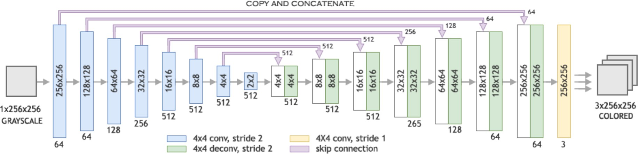
Generator’s Architecture : U-Net architecture

Slide 12
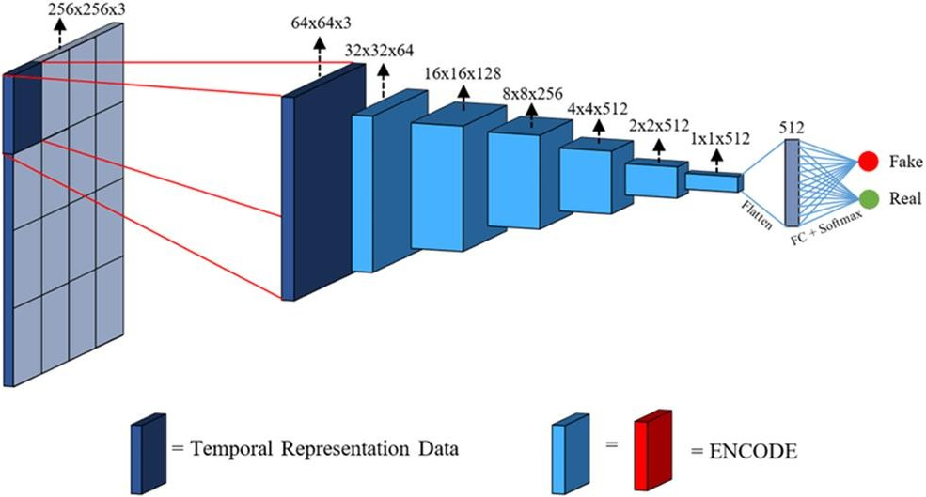
Discriminator’s Architecture :PatchGAN Architecture

Slide 13
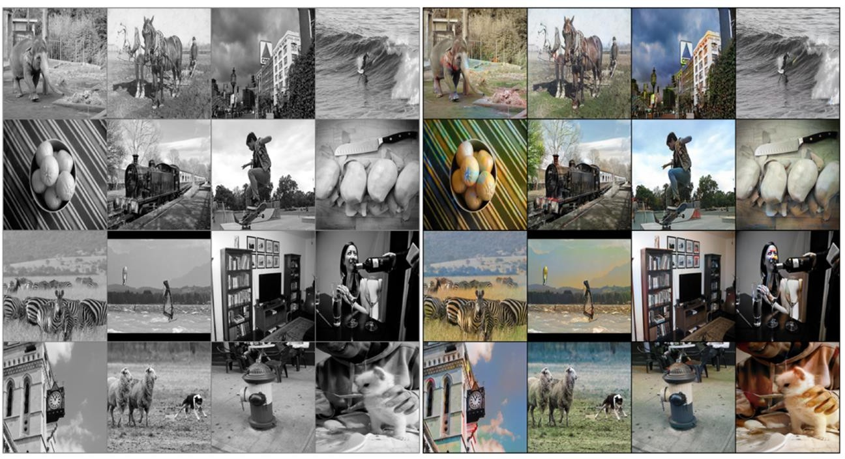
Expected Results
Output images after 100 epochs without pretraining

Slide 14
References
1] A. A. E. Richard Zhang, Phillip Isola, “Colorful image colorization,” 2016.
T. Z. A. A. E. Phillip Isola, Jun-Yan Zhu, “Image-to-image translation with conditional
adversarial networks,” 2016.
Q. C. Chenyang Lei, Yue Wu, “Towards photorealistic colorization by imagination,” 2021.
S. Liu, “Two decades of colorization and decolorization for images and videos,” 2022.
Y. D. X. D. J. L. Z. M. J. M. A. B. H. Y. Runsheng Xu, Zhengzhong Tu, “Pik-fix: Restoring and colorizing old photos,” 2022. [6] M. S. B. Mahmoud Afifi, Marcus A. Brubaker, “Histogan: Controlling colors of gan-generated and real images via color histograms,” 2020.
Department of Artificial Intelligence

Slide 15
VIDYA JYOTHI INSTITUTE OF TECHNOLOGY
(Autonomous)
THANK YOU
Department of Artificial Intelligence

